Slide 1
Lecture_07

Slide 2
Module_32

Slide 3
Introduction
Ogive curve
There are two types
Of curve
More than type
frequency curve
Less than type
frequency curve

Slide 4
Exercise 14.4 – Q.1
EX 14.4 (1)The following distribution gives the daily income of 50 workers of a factory.
Daily income (in Rs)
Daily income (in Rs) | 100 - 120 | 120 - 140 | 140 - 160 | 160 - 180 | 180 - 200
Numbers of workers | 12 | 14 | 8 | 6 | 10
Numbers of workers
less than type cumulative frequency
Convert the distribution above to a less than type cumulative frequency
distribution, and draw its ogive.
Second column will be frequency. In this sum it is number of worker
Third column will be less than type cumulative frequency. In this we add the frequency from Up to Down
draw its ogive
Sol.
+
= 26
Cumulative Frequency
26
Daily income (in Rs)
Numbers of workers
Points to be plotted
We will prepare less than type cumulative frequency distribution table.
First column will be continuous classes in this sum it is daily income (in Rs.)
12
(120,12)
100 - 120
12
12
Upper limit,cumulative frequency
Fourth column will be points to be plotted upper limit/cumulative frequency
26
120 - 140
14
14
(140,26)
+
34
= 34
8
140 - 160
8
(160,34)
160 - 180
6
40
(180,40)
180 - 200
10
50
(200,50)

Slide 5
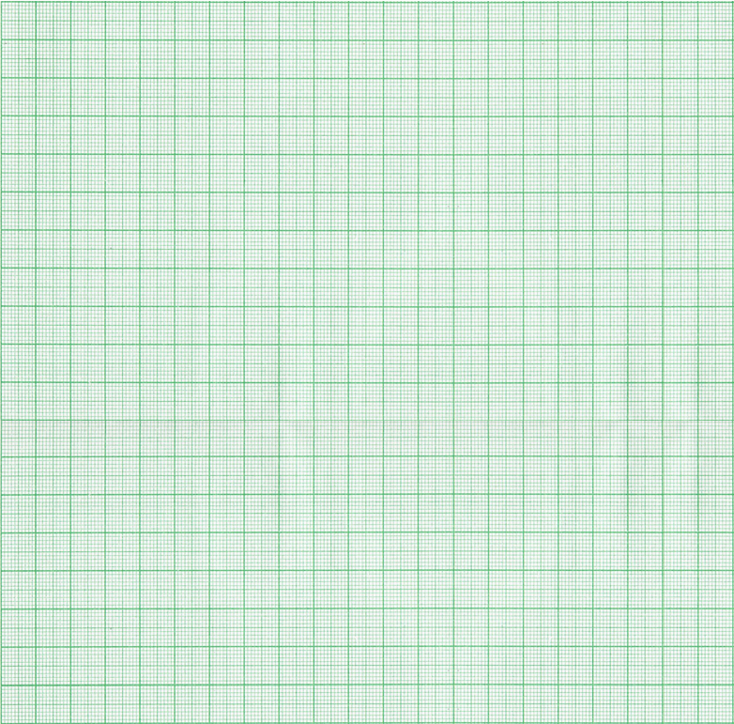
Exercise 14.4 – Q.1
y
Scale : X-axis, 1cm =Rs.10
Y-axis, 1cm = 5 workers
Leaving 2 cm from bottom we draw horizontal X-axis and leaving 2cm from left we draw vertical Y-axis
Points to be plotted
(120,12)
On X-axis if classes are not starting from ‘0’ leaving 2cm from X-axis we start putting limits .
(140,26)
Now let us plot the points on a graph
(160,34)
50
(200,50)
45
(180,40)
The difference between origin and lower limit of first class is not same as the width of classes hence we put a Krink mark
40
(180,40)
(200,50)
No. of workers
35
(160,34)
30
25
(140,26)
Looking at the biggest Y-co ordinate we select the scale on Y - axis
20
15
10
120
20
20
20
20
We plot the points one after the other and write the co-ordinate
(120,12)
5
x'
0
120
140
160
180
200
x
Join all points with smooth curve
y'
Daily income (in Rs)

Slide 6
X_CBSE_2017-18_Mod-29
Module_33

Slide 7
Exercise 14.4 – Q.3
EX.14.4(3) The following table gives production yield per hectare of wheat of 100 farms of a village.
Production yield (in Kg/Ha) | 50 - 55 | 55 - 60 | 60 - 65 | 65 - 70 | 70 - 75 | 75 - 80
Numbers of Farms | 2 | 8 | 12 | 24 | 38 | 16
Production yield
(in Kg/Ha)
Second column will be frequency. In this sum it is number of farms
Numbers of Farms
Change the distribution to a more than type distribution, and draw its ogive.
more than type distribution
draw its ogive
Third column will be more than type cumulative frequency. In this we add the frequency from Down to Up
Soln.
Sol:
Production yield (in Kg/Ha)
Numbers of Farms
Cumulative Frequency
Points to be plotted
50 - 55
2
100
(50,100)
We will prepare more than type cumulative frequency distribution table.
Fourth column will be points to be plotted lower limit,cumulative frequency
55 - 60
8
98
(55,98)
First column will be continuous classes in this sum it is production yield(in Kg/Ha)
60 - 65
12
90
(60,90)
65 - 70
24
78
(65,78)
70 - 75
38
54
(70,54)
75 - 80
16
16
(75,16)

Slide 8
Exercise 14.4 – Q.3
y
Scale : X-axis, 2cm =5 Kg/ha
Y-axis, 1cm = 10 farms
Leaving 2 cm from bottom we draw horizontal X-axis and leaving 2cm from left we draw vertical Y-axis
Now let us plot the points on a graph
Points to be plotted
On X-axis if classes are not starting from ‘0’ leaving 2cm from X-axis we start putting limits .
(50,100)
110
(55,98)
(50,100)
(55,98)
(60,90)
100
The difference between origin and lower limit of first class is not same as the width of classes hence we put a Krink mark
90
(60,90)
(65,78)
80
(65,78)
(70,54)
70
(75,16)
No. of farms
60
(70,54)
50
Looking at the biggest Y-co ordinate we select the scale on Y - axis
40
30
We plot the points one after the other and write the co-ordinate
20
50
5
5
5
5
5
5
(75,16)
10
Join all points with smooth curve
x'
0
50
55
60
65
70
75
80
x
y'
Production yield (in Kg/ha)

Slide 9
X_CBSE_2017-18_Mod-30
Module_34

Slide 10
Exercise 14.4 – Q.2
EX 14.4(2) During the medical check-up of 35 students of a class, their weight were recorded as, follows :
Weight
(in Kg)
Less than
38
Less than
40
Less than
42
Less than
44
Less than
46
Less than
48
Less than
50
Less than
52
Numbers of
students
0
3
5
9
14
28
32
35
Draw a less than type ogive
obtain the median
Draw a less than type ogive for the given data.Hence obtain the median weight from graph and verify the result by using the formula.
weight from graph
Weight
(in Kg)
Numbers of students
Cumulative Frequency
Point to be plotted
N
35
=
=
17.5.
Now, =
2
2
36 - 38
0
(38,0)
Which lies in the class 46 - 48
0
Median class is 46 – 48.
38 - 40
3
(40,3)
∴
3 – 0 = 3
40 - 42
5
(42,5)
∴ L =
46,
f =
14,
cf =
14
and h =
2
5 – 3 = 2
42 - 44
Median from graph is 46.5 kg
9 – 4 = 5
9
(44,9)
44 - 46
14 – 9 = 6
14
(46,14)
46 - 48
28
28 – 14 = 14
(48,28)
48 - 50
32 – 28 = 4
32
(50,32)
50 - 52
35 – 32 = 3
35
(52,35)

Slide 11
Exercise 14.4 – Q.2
Soln.
Leaving 2 cm from bottom we draw horizontal X-axis and leaving 2cm from left we draw vertical Y-axis
y
Points to
be plotted
Scale : X-axis, 1cm = 1 Kg
Y-axis, 1cm = 5 students
(38,0)
On X-axis if classes are not starting from ‘0’ leaving 2cm from X-axis we start putting limits .
(40,3)
(42,5)
(44,9)
Now let us plot the points on a graph
The difference between origin and lower limit of first class is not same as the width of classes hence we put a Krink mark
No. of students
(46,14)
(48,28)
(52,35)
35
(50,32)
(50,32)
30
(48,28)
(52,35)
Looking at the biggest Y-co ordinate we select the scale on Y - axis
25
20
(46,14)
(46.5)
15
We plot the points one after the other and write the co-ordinate
(44,9)
10
38
2
2
2
2
2
2
2
(40,3)
(42,5)
5
(38,0)
x
Join all points with smooth curve
x'
0
38
40
42
44
46
48
50
52
y'
Weight in Kg.

Slide 12
Exercise 14.4 – Q.2
N
- c.f
2
∴ Median =
L +
× h
f
17.5
- 14
=
46 +
× 2
14
7
0.5
3.5
46 +
=
7
=
46 +
0.5
∴ Median =
46.5
Hence the median is same as obtained from graph.

Slide 13
X_CBSE_2017-18_Mod-31
Module_35

Slide 14
HOMEWORK
Additional Example
Q. Construct a frequency distribution table for following distribution :
Age in year (less than) | 10 | 20 | 30 | 40 | 50 | 60 | 70
Cumulative frequency | 0 | 17 | 32 | 37 | 53 | 58 | 65
Similarly all upper limits are given to us
Since class width is 10 we get lower limit by subtracting 10 from each upper limit
The frequencies given to us are c.f. less than type as we observe they are increasing from top to bottom
For getting c.f. we add frequencies.
Similarly, for getting frequencies we subtract consecutive c.f.
Soln.
In c.f less than type the c.f. and the frequency of the first class is the same
The cumulative frequency table with class intervals is given by:
Class interval is given as less than 10 means 10 is upper limit of that class
Class
interval
Cumulative
frequency
Age in years
Frequency
In this problem classes given are
17 – 0
= 17
Less than 10
0 –
10
10 – 10
= 0
0
0
32 – 17
= 15
Less than 20
10 –
20
20 – 10
= 10
17
37 – 32
17
= 5
Less than 30
20 –
30
30 – 10
= 20
32
15
53 – 37
= 16
Less than 40
30 –
40
37
5
58 – 53
= 5
Less than 50
40 –
50
53
16
65 – 58
= 7
Less than 60
50 –
60
58
5
Less than 70
60 –
70
65
7

Slide 15
Module_36

Slide 16
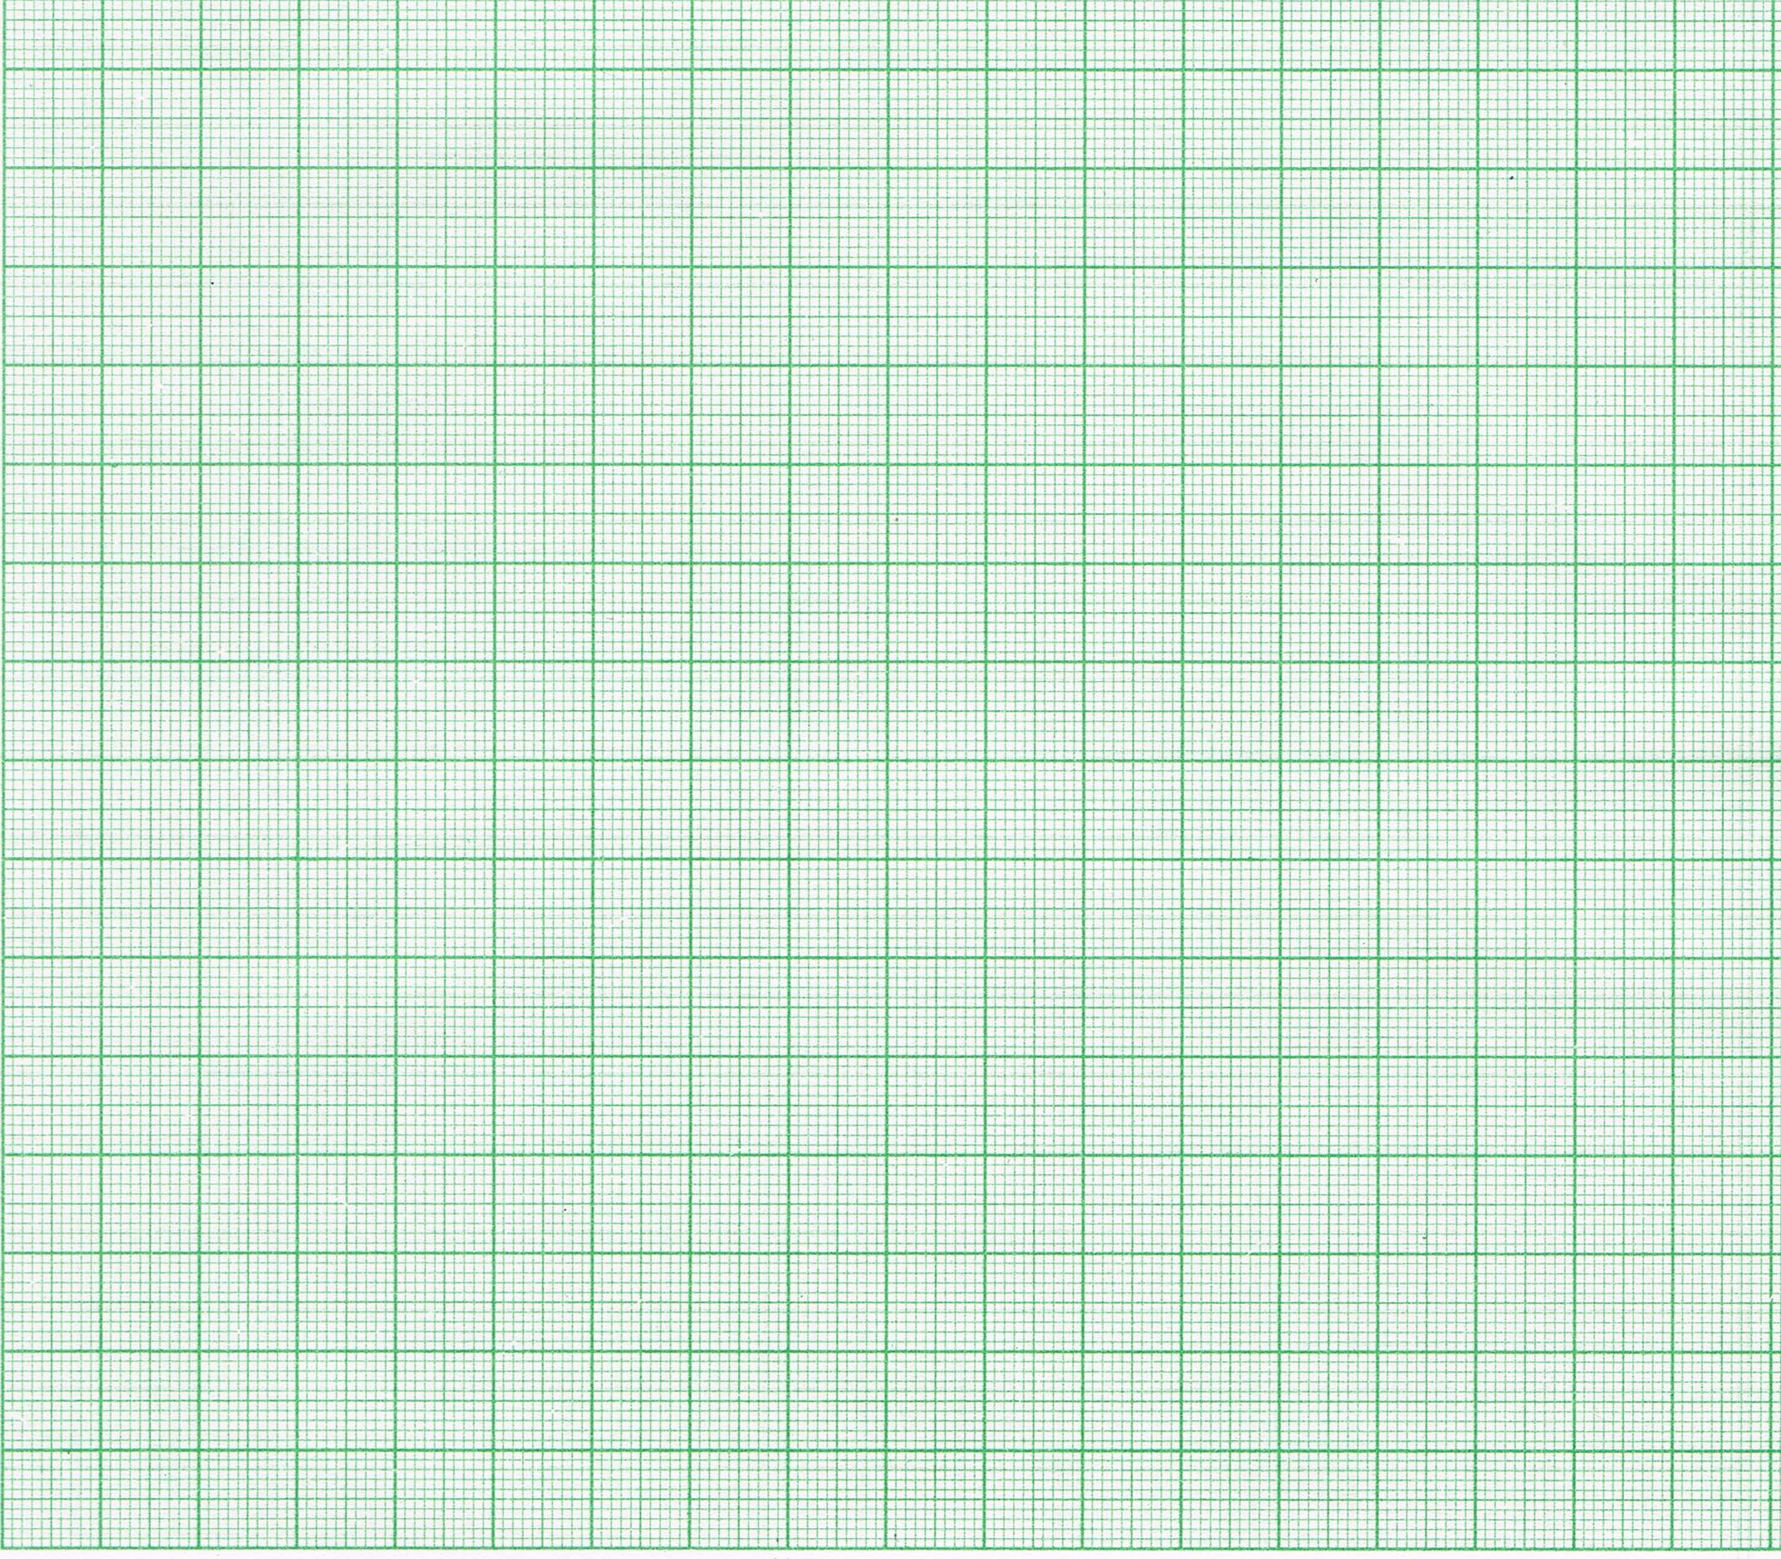
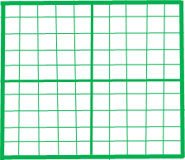
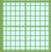
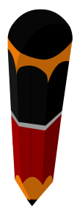
Additional Example
HOMEWORK
Q. Draw an ogive to represent the following data:
Scale :
2 cm = 5 units on x-axis
140
140
1 cm = 10 units on y-axis
(40, 139)
Class Mark
12.5
139
17.5
22.5
27. 5
32 .5
37 . 5
110
130
{
109
40
x co-ordinate is upper boundary of class
Frequency
12
17
22
120
31
27
30
y co-ordinate is cumulative frequency less than type
130
1 cm
(35, 109)
So, introduce a class before 1st class with frequency zero
Mark c.f. less than on Y-axis
Sol:
Now plot the points
110
Class mark & frequency is given
100
32
From class mark subtract 2.5 to get lower limit and add 2.5 to get upper limit
Let us find co-ordinates of points to be plotted
100
1 cm
31
=
Upper
Boundary
u_{i}
10 boxes
80
Let us find class interval using given class marks
Class interval
Frequency
f_{i}
Cumulative Frequency
30
Class marks
Class interval
No. of students
78
10 boxes
=
10 units
90
30
1 box = 1 unit
(30, 78)
5 – 10
10
80
What is highest c.f.?
0
0
Class mark is mid point of classes
12.5
First find the class width by subtracting two consecutive class mark
10 – 15
12
+
70
60
70
Since we have 20 cms on
Y-axis, we will consider simplest scale 1 cm = 10 units
Divide class width by 2
10 – 15
12
15
12
5 ÷ 2 = 2.5
= 30
= 20
= 15
= 10
= 35
– 2.5
= 25
– 2.5
– 2.5
– 2.5
– 2.5
32.5
– 2.5
22.5
17.5
12.5
37.5
17.5
15 – 20
17
27.5
+
60
Join these points with smooth curve
(25, 51)
15 – 20
17
20
29
= 35
= 25
= 20
= 15
= 40
+ 2.5
= 30
+ 2.5
+ 2.5
+ 2.5
+ 2.5
32.5
+ 2.5
22.5
17.5
12.5
37.5
27.5
Cumulative frequency
22.5
20 – 25
51
22
50
Since frequency of 1st class is not zero
+
30
50
27.5 – 22.5 = 5
20 – 25
22
25
51
29
40
Mark upper class boundaries on X-axis
27.5
+
25 – 30
27
(20 , 29)
25 – 30
27
30
20
78
30
32.5
+
20
30 – 35
30
20
(15, 12)
30 – 35
31
35
109
139
+
37.5
35 – 40
12
31
10
35 – 40
30
40
10
139
(10, 0)
0
10
15
20
25
30
35
40
X
Class interval

Slide 17
Thank You

